Slide 1

Inmarsat Fleet Xpress Service
錢聲偉
VP Sales , Asia Pacific , Inmarsat Maritime

Slide 2
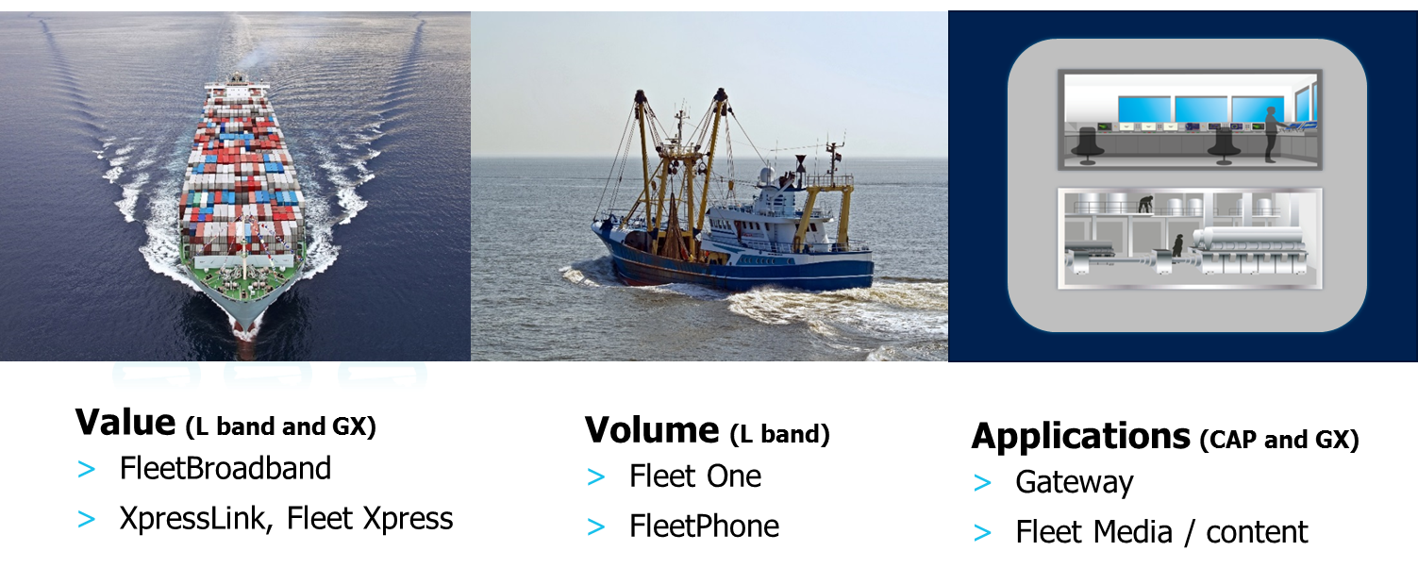

The 2016 Inmarsat Portfolio
A broad range of products & service to address all Maritime needs
High Volume Data, Internet
Lower Volume Data, Email
Applications
Fleet Xpress
FleetBroadband
FleetBroadband
Fleet One & FleetPhone
Developer Partnerships
Maritime Applications
Fleet Media / Content

Slide 3

The Maritime Market
High Bandwidth
1,800
320
Rigs and platforms
Cruise vessels
46,000
67,000
Large fishing
10,900
6,600
Super Yachts
Offshore supply vessels
Regional
Mobility
6,180
Global
Mobility
Ferries
233,000
Leisure
324,000
Merchant shipping
Small fishing boats
Low Bandwidth
Source: Inmarsat Market intelligence

Slide 4
2016 Inmarsat Portfolio Relevance
High Bandwidth
1,800
320
FX/GX
Rigs and platforms
Cruise vessels
46,000
67,000
Fleet Xpress
Large fishing
10,900
6,600
FleetBroadband
Super Yachts
Offshore supply vessels
Regional
Mobility
6,180
Global
Mobility
Ferries
233,000
Fleet One
Leisure
324,000
Merchant shipping
FleetPhone
Small fishing boats
Low Bandwidth
Source: Inmarsat Market intelligence

Slide 5

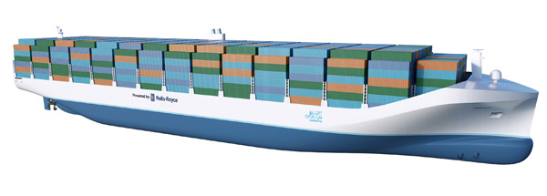
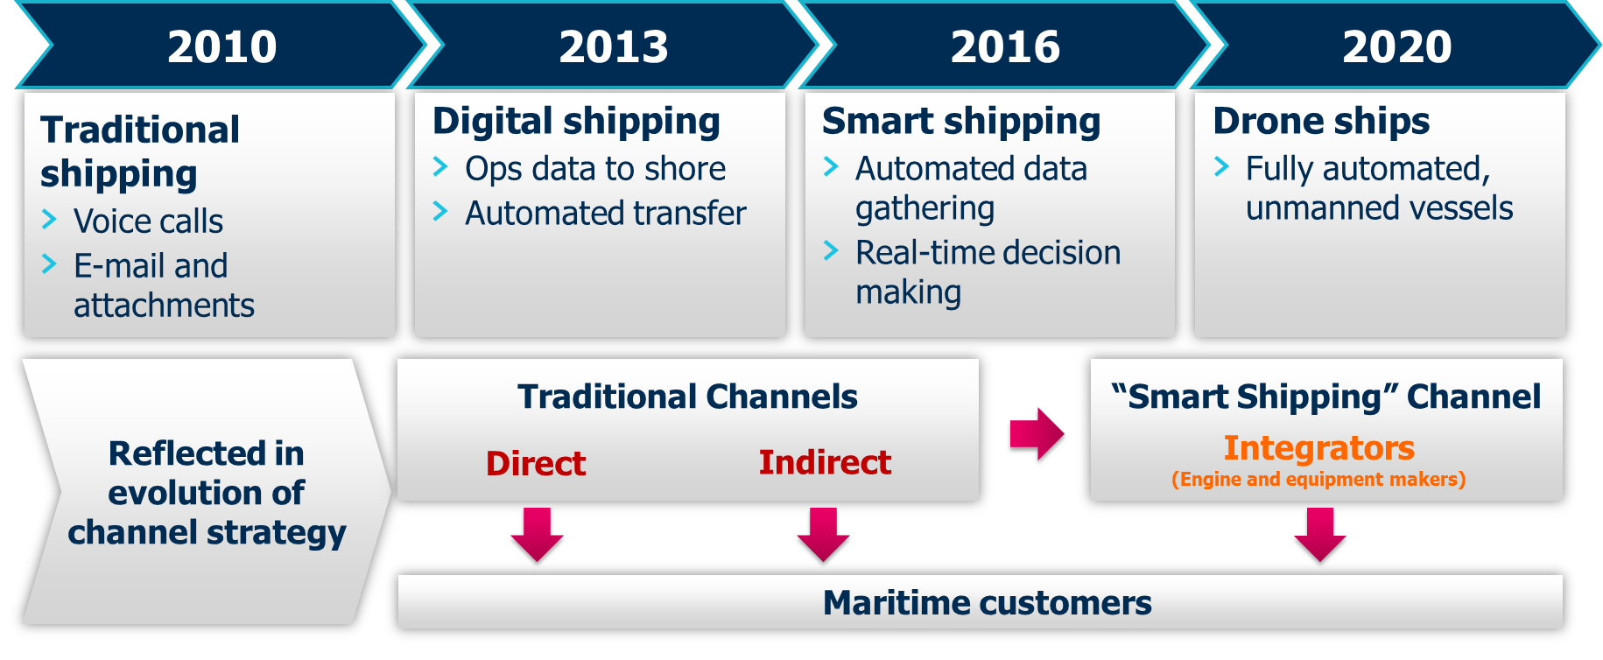
The landscape of shipping is changing forever

Slide 6

0.05
2,800
seconds between each motion
sensors hardwired into the Triple E vessel's main control system.
measurement on a ship.
5,000
Data tags on modern vessel
$20M
fuel cost savings
in 2014
200
30 TB
data transmitted by the Maersk Line fleet over satellite link every month.
sensors in a modern main engine room measuring temperature, pressure and operations.
2TB
Data generated every 100 days by a modern vessel
2 GB
data stored every day from the main control system of a Triple E vessel.
4,000
channels monitored on the Triple E for situational awareness and alarms.

Slide 7

INTERNET of
OCEANS
THINGS

Slide 8

GLobal Xpress 服務
MARITIME > Fast Track to Fleet Xpress
03

Slide 9

Inmarsat Global Xpress
$1.6bn
2016
89
Global broadband network
Commercial launch
Ka-band beams on each satellite
One high speed network, one trusted provider, one seamless global solution
    Next generation high throughput satellites
    One single operator delivering seamless coverage, worldwide
    Powered by three Inmarsat-5 satellites built by Boeing
    Each I-5 satellite has an expected lifespan of 15 years
    Wide range of terminals
    Fleet Xpress is the maritime Global Xpress solution

Slide 10
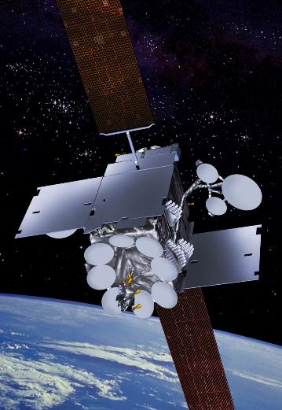

Global Xpress status and overview
Three I-5 satellites (+ F4 as spare or additional s/c)
F1 Successfully launched 08 Dec 2013
F2 Successfully launched 01 Feb 2015
F3 Successfully launched 28 Aug 2015
Global Service (Baseline Payload)
  89 fixed beams per satellite for global coverage in three satellite configuration
  Designed for mobility and fixed services
Regional Service (High Capacity Overlay Service)
  6 steerable spot beams per satellite for multi-regional, dynamic coverage
  Concurrent commercial & military Ka-band services
Trusted ground network
Notes:
This is an update slide.
It shows the timelines of the current events. You can add the expected Global CSI date of early 2nd half 2015 but this is explained at the end.
The regional overlays will not be controlled by the maritime service but will support them.
Of the 89 beams only 72 are used. Beams can be over layed so there are two in any one spot doubling the capacity.
There is a total of 5GHz of capacity per satellite a total of 15GHz over the 3 satellites. Most Ku band satellites have less than 1GHz each
The satellites are only part of the GX network the SAS (Satellite Access Stations) are key and they bring the traffic to and from the customer.
Looking at the satellite picture you can see 6 spot beams, these are the three dishes either side, there are two dishes in the middle, top and bottom, which are the channels to the SAS. The extended flat plates on either side of the satellite are the 89 beams and are not shown very well.

Slide 11
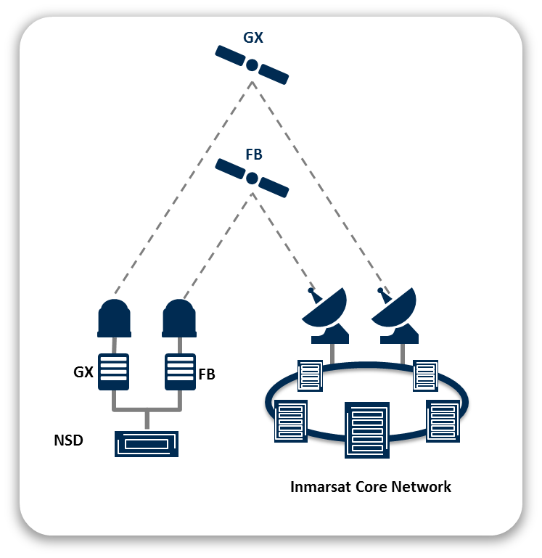
Fleet Xpress
  Global coverage with regional efficiency
  Fleet Xpress is a fully integrated Ka- and L-Band service
  Satellite and beam switching is fully automated
  Users do not have to worry about their location and
  the beam status
  Ultimate reliability
  Dual satellite constellation with Global Xpress and
  FleetBroadband back-up
  Fleet Xpress ground stations are built with redundancy
    Secondary earth stations as a back-up
  Remote diagnostics and maintenance of shipboard systems

Slide 12
The Fleet Xpress Solution
GX
FB
GX
FB
Network
Service Device
Inmarsat Core Network
Empowering Maritime Community Solutions

Slide 13
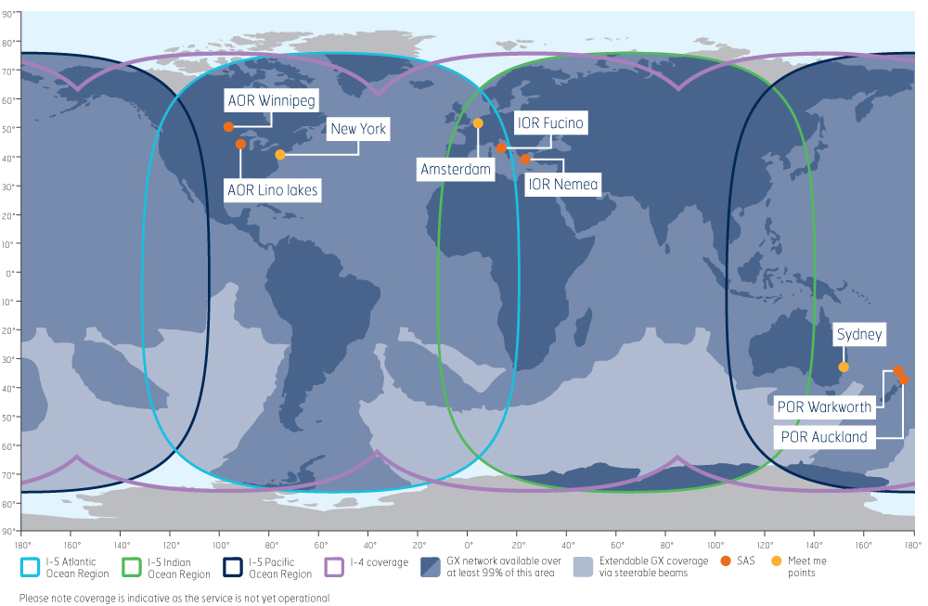
Fleet Xpress Coverage

Slide 14
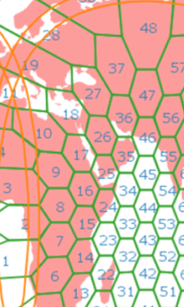
Fleet Xpress Network Basics
  Unique, spot beam design
  Global beam composed of 89 spot beams
  Frequency reuse ensures high capacity in
  each individual spot beam
  Seamless switch between spot beams
  Dynamic Network Management
  Bandwidth Sharing Capability
  Load balancing between beam pairs
  Additional steerable beams for additional
  capacity in high traffic areas

Slide 15
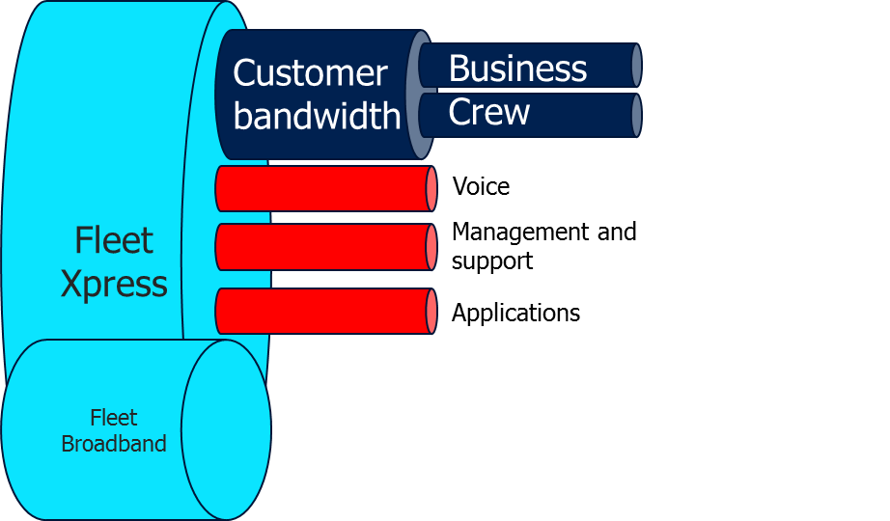
Fleet Xpress Subscriptions
  Revolutionary satellite network design allows for flexible bandwidth management
  Bandwidth elements
  Customer bandwidth for business and crew use
  Voice as separate pipe
    Does not take away from business and crew
  Certified Application Partner (CAP) applications
  Support & Redundancy Elements
  Site management and support for service assurance
  FleetBroadband back-up
    Includes seamless backup for voice traffic

Slide 16
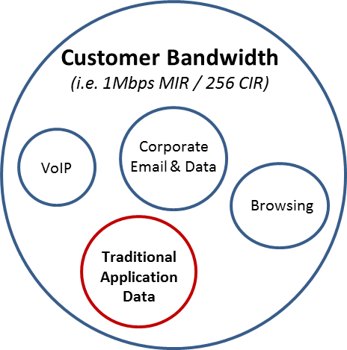
Flexible Real-Time Bandwidth Control
Entire GX Bandwidth Capacity
GX Dynamic Bandwidth Allocation
Certain Apps may require additional bandwidth
    Short term, high volume data needs
    Customer does not want business traffic negatively impacted
    Prepaid Applications, when the crew
    is paying for airtime directly

Slide 17

Flexible Real-Time Bandwidth Control
Entire GX Bandwidth Capacity
Temporary Bandwidth
GX
Application control of Bandwidth
Uses API to open additional bandwidth
Data traffic is passed over the satellite
Application closes bandwidth

Slide 18
Secondary Monthly Subscription
Entire GX Bandwidth Capacity
Customer Base GX Subscription
Monthly
Invoice ($)
Secondary/ Multiple
Monthly
Subscription
Monthly
Invoice ($)
Ship Owner
Data traffic
Data traffic
Crew Browsing
Email
Application Data
2nd users, engine monitoring
VDR, Nav systems, etc….
Business / Crew LAN
Vessel Equipment LAN

Slide 19

Voice Services
  Native Voice Services provided as part of FX
  Global Xpress is the primary service
  Supports 25 x IP phones onboard
  Allows 5 simultaneous calls
  Analogue and IP phones can be used
  FX Voice Features
  Dedicated allow direct dialing (Captain’s Phone)
  Shared phones require PIN and/or prepaid code (Crew)
  Voice calls do not consume the primary bandwidth
    No slowdown for data or Internet access
  Customer VoIP
  FX has no restrictions on customer / crew voice services
  Customers are free to use these services as they wish
  Traffic with VoIP is carried in the customer’s bandwidth

Slide 20
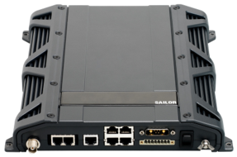
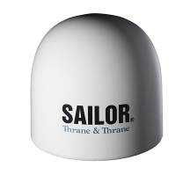
FleetBroadband Backup Services
  Unlimited FB Backup included with every FX subscription
  Global Xpress (Ka-Band) is the primary service
  Network Service Device manages FleetBroadband
  switchover automatically
  Fleetbroadband Support
  Supports FB500 and FB250
  Can connect 2 x FB terminals but only one is used at a time
  FB Traffic Support
  Corporate data is transferred to FleetBroadband
  GX CIR is not supported on FB
  All FB usage included, no extra charges
  One voice line will be backed up over FleetBroadband initially, which will expand to more later in 2016
  No change to voice call pricing

Slide 21
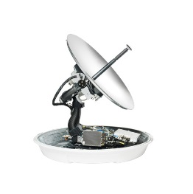
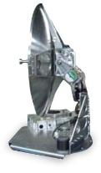
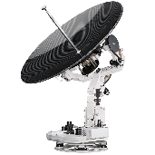
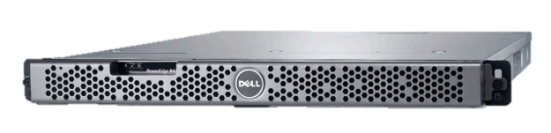
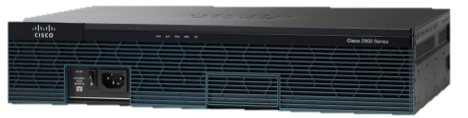



Fleet Xpress terminals
Inmarsat tested and approved equipment from trusted hardware partners
Maritime GX and FB terminals:
  1m or 60cm GX terminal
  FB500 or FB250 terminal
Network Service Device (NSD)
Manages the traffic flow and bandwidth allocation on the ship
Approved terminals and compact antennas from selected manufacturers are simple to install, support the one platform and ensure a future proof hardware

Slide 22

Applications and Services
Third Party Applications and Services hosted and managed through the FX Gateway
Engine Monitoring
Planned Maintenance
Chart Updates
Weather / routing
Safety & compliance
Operational efficiency
Emissions monitoring
Anti-piracy
Telemedicine
Remote surveillance
IT & Security
Crew welfare
Remote IT support
Corporate email
Voice & Video Chat
Cyber Security
Internet Access
Voice & Video
Current news & sports
TV, Radio & Gaming
An ecosystem of applications and services available through Fleet Xpress

Slide 23





The new standard in maritime communications
Five powerful sets of benefits that together make Fleet Xpress unique
        Ultimate reliability through a dual satellite constellation using Ka-band with unlimited L-band back-up, ensuring seamless global mobility
The New standard in maritime communications
        A unique opportunity for enhanced operations by deploying value added services developed by third party application providers
        Committed data rates backed-up by service level agreements guarantee that the customer always gets what they pay for
        Standardised plug-and-play service facilitates 24/7/365 management, monitoring and support globally, for simplicity and complete peace of mind
        More accurate cost management with a wide selection of flexible subscription packages and one invoice
Notes:
CONTINUOUS CONNECTIVITY: Hybrid Ka and L-band service for ultimate reliability and seamless global mobility
GUARANTEED PERFORMANCE: Committed data rates backed up by service level agreements
CONTROLLED COSTS: Accurate cost management with flexible subscriptions and one invoice
FULLY MANAGED SERVICE: Plug-and-play service with 24/7/365 management and support
BUSINESS APPLICATIONS: Enhance operations and performance by deploying third party value added services

Slide 24
Comparing Fleet Xpress and FleetBroadband
  Fleet Xpress
  FleetBroadband
High throughput Satellite Yes No
Committed information rate Yes “Best effort”, 432Kbps max
Data capability: operational traffic High volumes Low - medium volumes
Data capability: internet browsing High volumes Low - medium volumes
Data capability: streaming/dedicated Yes Streaming IP option
(256Kbps maximum)
Weather interference None
Equipment cost $$ $
Equipment maintenance requirements Annual service recommended Very low
Bandwidth on demand features Yes Not at this time
Certified Application Partner (CAP) Program Support Yes Not at this time
Ka-band more susceptible
FleetBroadband back up for service assurance

Slide 25

  全球服務: 2016年三月一日
  Defining Connectivity at Sea
© Copyright Inmarsat Global Limited 2015

