Slide 1


The Shipdex protocol
(www.shipdex.com)
WHY
WHAT
HOW
Marco Vatteroni
Director
Shipdex author & technical manager

Slide 2
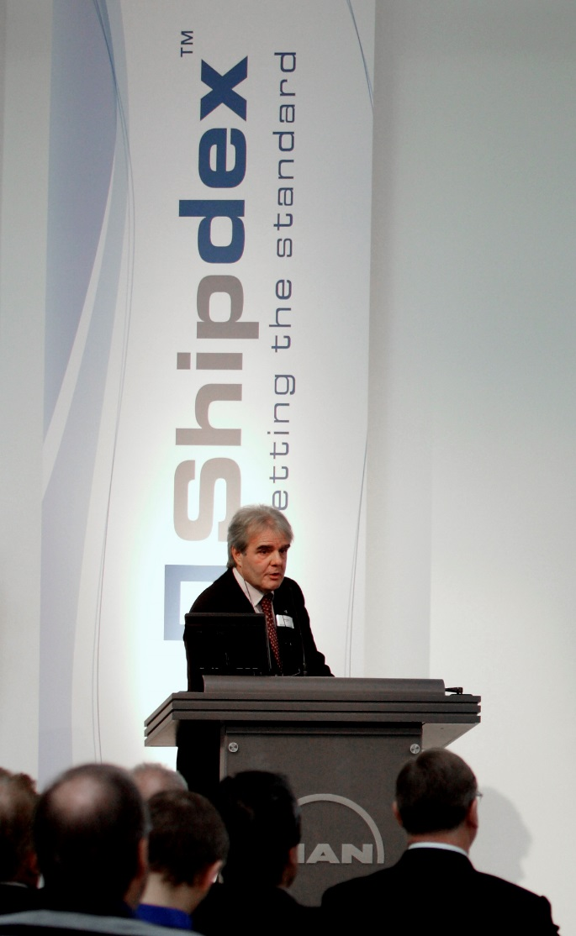
My last experiences
Shipdex Consulting Ltd (2016 - )
  Shipdex Consulting Director
  Shipdex author and technical manager inside the non-profit Shipdex organization
  Shipdex representative at S1000D Steering Committee
SpecTec Group (2006-2016)
  ILS and Shipdex manager
  Shipdex author and technical manager inside the non-profit Shipdex organization
  Shipdex representative at S1000D Steering Committee
Italian Fincantieri shipyard (2002 – 2006)
  IT manager at ILS Department
  PM of technical publication projects based on S1000D™ standard:
    Italian Navy “new aircraft carrier Cavour”
    Italian-French “Horizon Frigates”
    Italian-German “U212A submarines”

Slide 3

The Shipdex Consulting Ltd
(Italy – Cyprus – Hong Kong)
We are acting as Technical Manager inside the non-profit Shipdex organization
Our mission is to offer the best support to all those organizations who decide to approach the Shipdex Protocol
Our services and software products are directed to any kind of organization working in the shipping market, as:
  Manufacturers
    Shipyards
      Ship-owners
        IT companies
          Engineering companies
            Class Societies

Slide 4
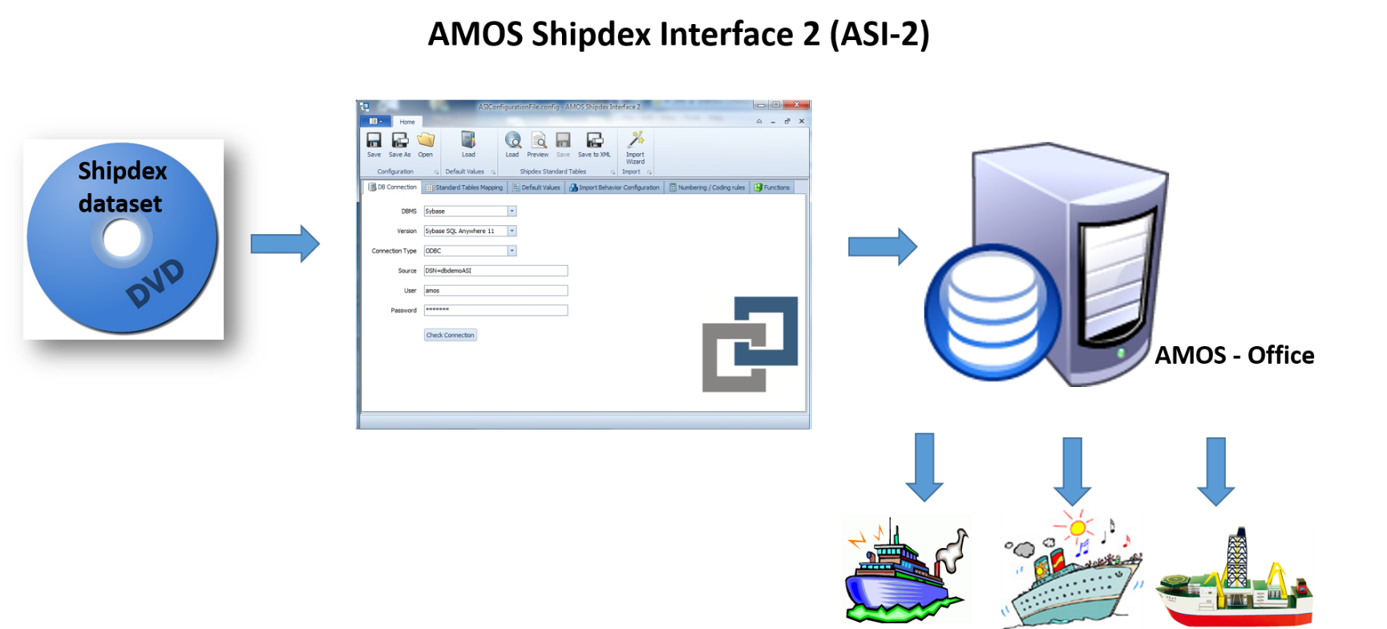
The Shipdex Consulting Ltd
(Italy – Cyprus – Hong Kong)
Our services:
  Shipdex training and consultancy
  Assistance during the Shipdex process start-up
  Conversion of pdf manuals to Shipdex standard
  Support in developing Shipdex compliant IT applications
  Production of Computer Based Training
Our software tools:
  Shipdex Enterprise Management Suite
  AMOS Shipdex Interface 2
Visit us on www.shipdexconsulting.com

Slide 5
WHY
THIS TECHNICAL MANUALS FRO MY NEW SHIPS ?!

Slide 6

THESE TECHNICAL MANUALS FOR MY NEW SHIPS ?!

Slide 7
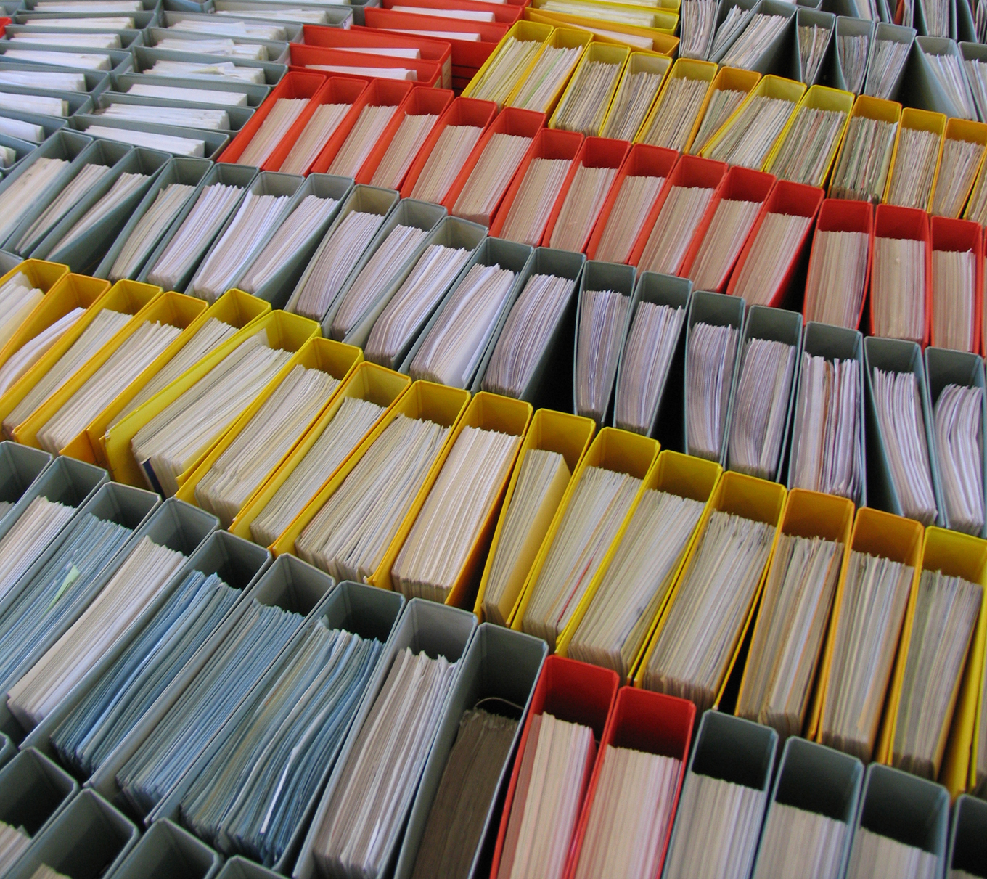
This is how many technical manuals
are still supplied today
with a new ship!

Slide 8


WHY
PAPER OR PDF FORMAT
DIFFERENT STRUCTURE
DIFFERENT LAYOUT
DIFFERENT QUALITY
Paper manuals
In other words:
Today we produce, exchange and use “pages of information”
PDF manuals

Slide 9

WHY
HIGH MANAGEMENT COSTS
HIGH RISK TO USE NOT UPDATED INFORMATION
HIGH RISK TO BUY THE WRONG SPARE PARTS
NO INTEGRATION WITH COMPANY IT SYSTEMS
In other words:
LOW QUALITY AT HIGH COST
A
Nightmare !

Slide 10

WHY
IS THERE AN
EFFECTIVE SOLUTION ?

Slide 11
WHAT
THIS TECHNICAL MANUALS FRO MY NEW SHIPS ?!

Slide 12


WHAT
Why Shipdex
The Effective Solution is

Slide 13
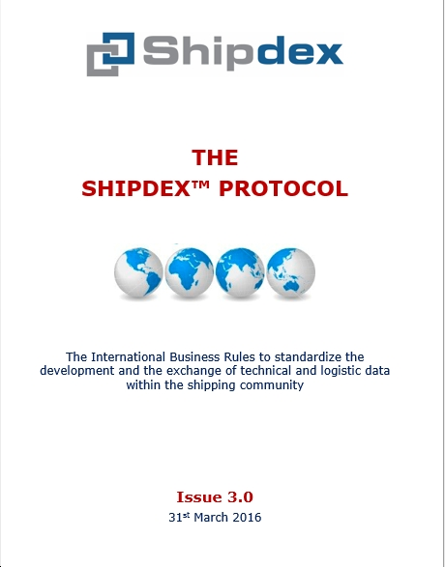
WHAT
The Solution
In other words:
HIGHER QUALITY AT LOWER COST
(www.shipdex.com)

Slide 14


WHAT
The Shipdex working group was created on 2007 to cover the shipping supply chain.
It includes:
  Manufacturers
  Ship-owners
  IT company (SpecTec)

Slide 15
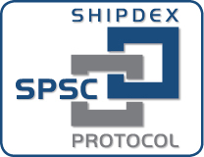

WHAT
Today, the Shipdex Organization is composed of:
SPSC - Steering Committee
SPSC – SPMG members
Alfa Laval
Grimaldi Group (Shipdex chairman)
Intership Navigation
MacGregor
Man Diesel & Turbo
Mastermind Shipmanagement
Shipdex Consulting (Shipdex technical manager)
Yanmar Company
SPMG joint members
Rolls-Royce Marine
Furuno
SPMG - Maintenance Group

Slide 16
WHAT
Shipdex is an independent and non-proprietary standard protocol, open to all shipping players who wish to adopt it
Shipdex is a collection of business rules and writing rules developed to standardize and improve the production and the exchange of technical information.
Shipdex offers ship-owners the opportunity to eliminate or reduce the traditional pain and high costs in managing and importing technical data into corporate IT systems

Slide 17


WHAT
Shipdex is the S1000D customization for the shipping community

Slide 18

WHAT
S1000D is the former Spec 1000D, issued about 30 years ago for the European aero-space market
www.s1000d.org
Now it covers air, land and sea environments and is sponsored by:
  ASD Aerospace and Defence Industries Association of Europe
  AIA Aerospace Industries Association of America
  ATA Air Transport Association e-Business program
It is the international Technical Publication Specification for the military community and the civil aviation community
Shipdex™ is an Observer Member at S1000D Steering Committee

Slide 19

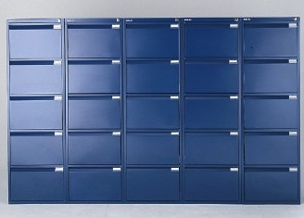

WHAT
The Common Source DataBase (CSDB)
Component B
Component C
Component D
Common Source DataBase
Shipdex
Component A
Component E
Dataset A
Shipdex
Dataset B
Common Source dataBase
Shipdex
Shipdex
Dataset C
Dataset D
Service
Bulletins

Slide 20
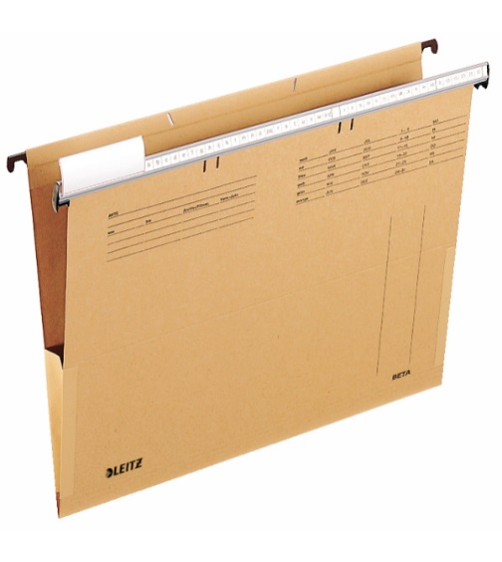



WHAT
Common Source DataBase
941
Illustrated Parts Data
921
Component A
Component B
Component C
Component D
Component E
Remove and Install procedures
Illustrations
300
Inspections

Slide 21

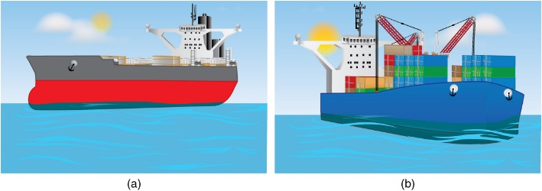
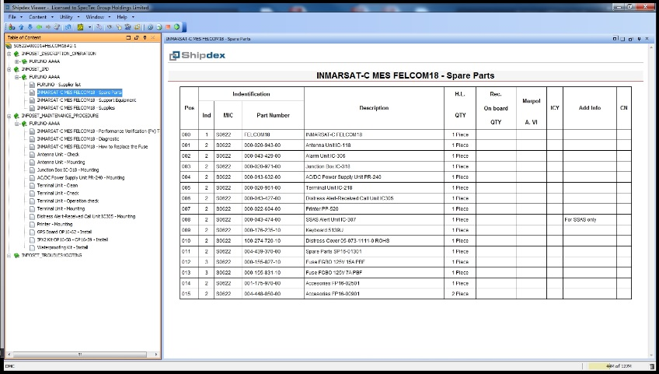

WHAT
Shipdex
Shipdex
Service
Bulletins
ERP
Dataset A
Dataset B
CMMS
Company
CSDB
Customized structure and layout
Technical office
External “world”

Slide 22
WHAT
Main benefits for manufacturers
Possibility to interface with Engineering and ERP systems
Standardisation of technical data production
Data production under Quality Assurance, Versioning and Configuration Control
Possibility to convert legacy manuals to Shipdex™
Reduced creation and update costs, due to data re-usability
Electronic storage in a structured CSDB
Improved Service Bulletins/Letters management
Manufacturer
CSDB
HIGHER QUALITY AT LOWER COST

Slide 23
WHAT
Main benefits for shipyard and ship-owners
Technical manuals are standardized in:
  Structure and composition
  Content
  Electronic format (just one browsing system)
  Preferred layout
Shipdex datasets can be reused many times for many ships
Data integration between technical information and CMMS, ERP, etc.
Reduced maintenance task duration thanks to faster possibility to retrieve information
Reduced risks to use not updated information
Customer
CSDB
HIGHER QUALITY AT LOWER COST

Slide 24
HOW

Slide 25

HOW
Short demonstration:
Shipdex datasets
How to browse and print Shipdex datasets
You can contact me at
mv@shipdexconsulting.com
info@shipdexconsulting.com

