Slide 1

WELCOME
TO
TAIWAN
SPECTEC
USER CONFERENCE

Slide 2
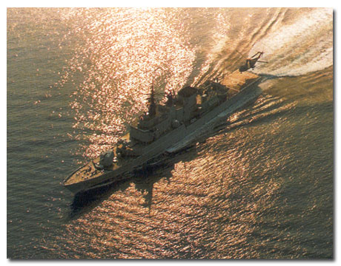
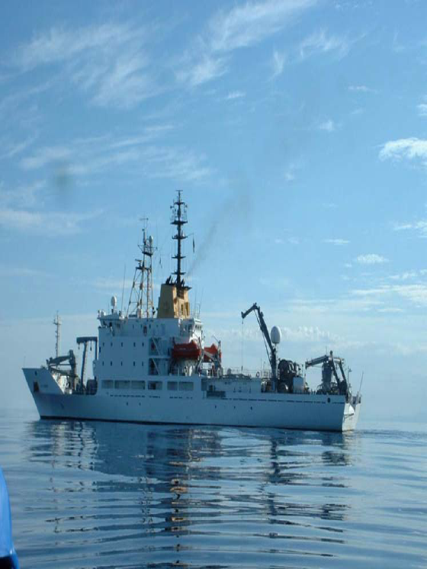
Who am I
Giampiero Soncini
  Italian Navy Officer – 14 years
  NATO Ship Manager – 13 years
  SpecTec (since 1998):
    MD Italian office
    VP South Europe
    VP sales worldwide
    CEO since 5 May 2005

Slide 3
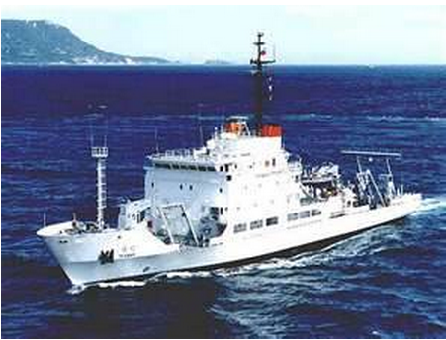
My destiny
TN DA QUAN
RV ALLIANCE

Slide 4

Who was here last year?
If you were, you may recall some of my slides
WE LIVE IN DIFFICULT TIMES FOR SHIPPING

Slide 5
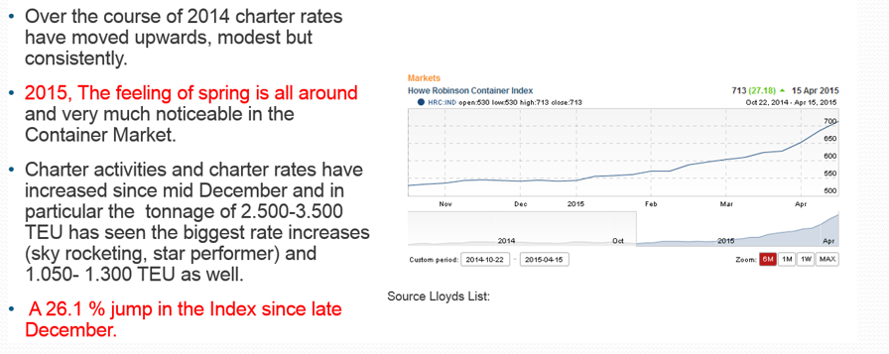
Situation in 2014
2015

Slide 6
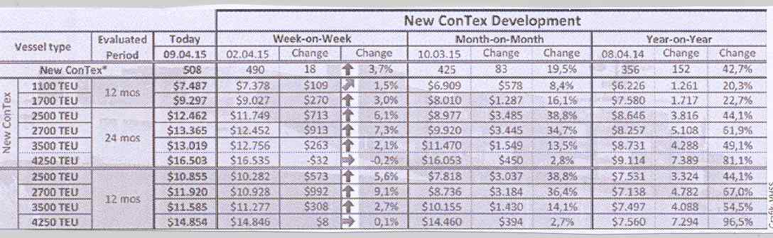
CHARTER RATES TRENDS
2015

Slide 7
NEWBUILDINGS
2015
The total order book stands at 3,4 mn TEU, which equals some 450 vessels or 19 % of the existing fleet.
Very low number of vessels, capacity on order plus 50% compared to 12 years ago.
307.000 TEU were already delivered in 2015.

Slide 8
MEGASHIPS ORDER BOOK
2015
MSC 20 x 19.224 TEU
UASC 6 x above 20.000 TEU
MOL 6 x 20.150 TEU
OOCL 6 x 21.000 TEU
MOSK 4 x 20.000 TEU plus 2 chartered in
CSCL 3 x ?
CMA CGM 3 x 20.600 TEU plus 6 x 18.000 TEU, delivery started
COSCO planning 11 x 19.000 TEU, YANG MING equal size
EVERGREEN time chartered 11 x 18.000 TEU
MAERSK to follow by mid year?? 10 x 20.000 TEU
HAPAG-LLOYD decision expected in a few months
Higher box stacks in hold and on deck enable yards to built bigger ships without changing dimensions. By lifting the deckhouse to ensure visibility, yards can create 11 tiers in the holds and 11 on deck. Only a matter of time before we see 12 tiers on deck.
ALL ARE RESTRICTED TO ASIA TO EUROPE TRADE

Slide 9
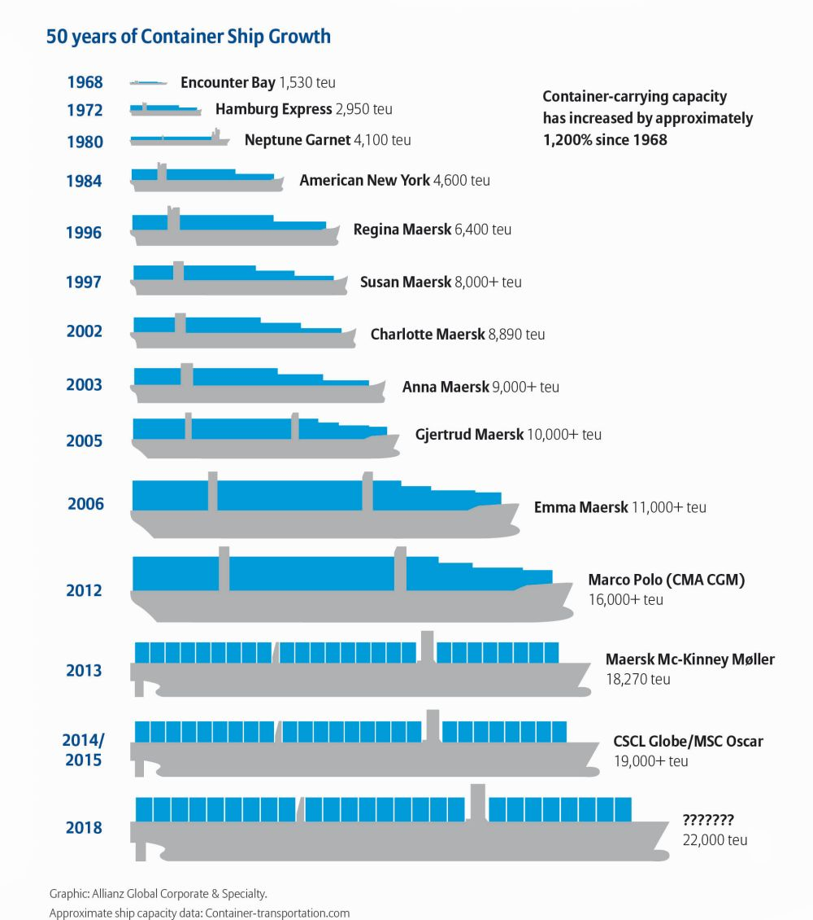
2015

Slide 10
IDLE FLEET & SCRAPPING
Idle Fleet: The number of smaller units below 3.000 TEU has shrunk to the lowest level in 4 years
  69 units 500 – 2.999 TEU (135, 2014)
  34 units above 3.000 TEU (Alphaliner).
Box ship scrapping set to remain high after more than 1 mn TEU scrapped past three years (2012/2014). Estimate 300.000 TEU.
  HAPAG-LLOYD announced to scrap 16 units in 2015.
  57.000 TEU scrapped in 2015.
2015

Slide 11
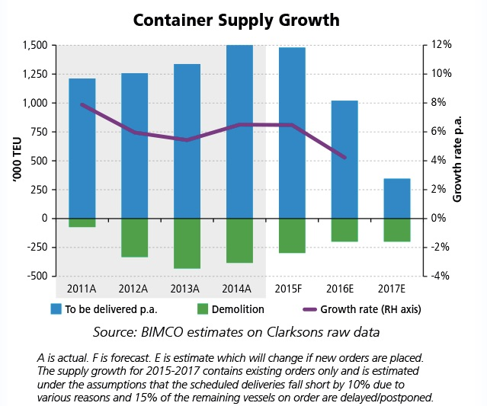
MARKET OUTLOOK
2015
Container Market gets bigger in every way. The increasing dominance of the giant container ships is the most notable current trend in this sector.
Box throughput set to reach 1 bn TEU come 2020 with Asian share of 65 %. Continued growth through out Asia will lead to 40% increase in global traffic (Drewry). (2013: 623 mn TEU).
Ports will come under increasing pressure to provide the necessary infrastructure to facilitate the mega ships and the rapid growth in demand. Larger crane, longer berths, yard space, berth productivity and efficiency.

Slide 12
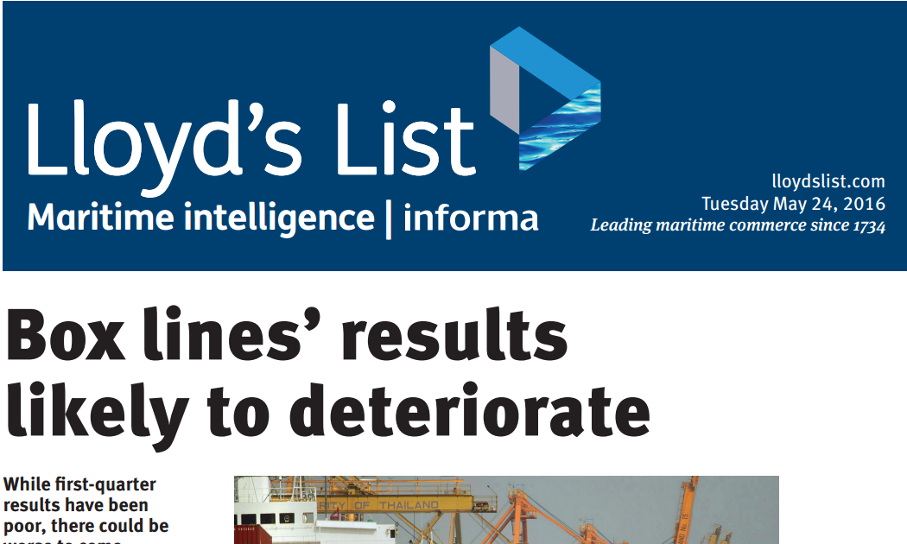
RESULTS?
CT MARKET IS AT THE LOWEST LEVELS EVER WITH LITTLE SIGNS OF GETTING BETTER

Slide 13
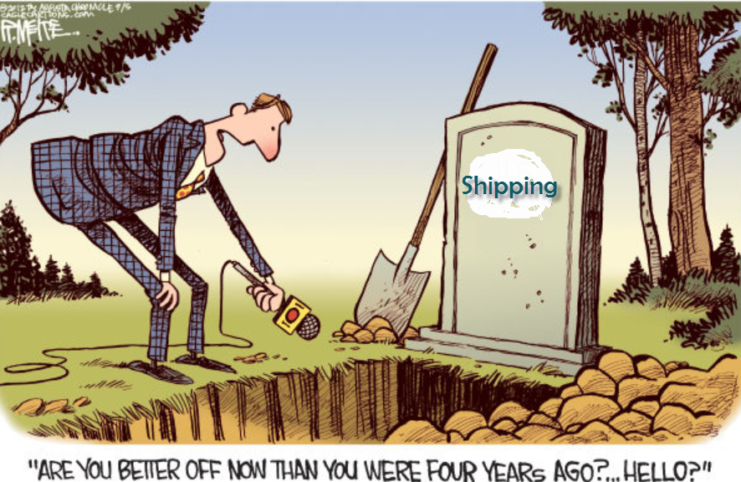
AND THE BULK MARKET?

Slide 14

Dry Bulk Market
5th May 2008
BDI at 11793 points.

Slide 15

Record Low
18th February 2015
BDI at 509 points

Slide 16

And we thought it would never go lower !!!

Slide 17
“Shipping is a variable and cyclical business
and anyone who thinks they can forecast it
needs their head examining.”
Dr Martin Stopford of Clarksons
Disclaimer from 5th Hydra Shipping Conference in September 2013

Slide 18
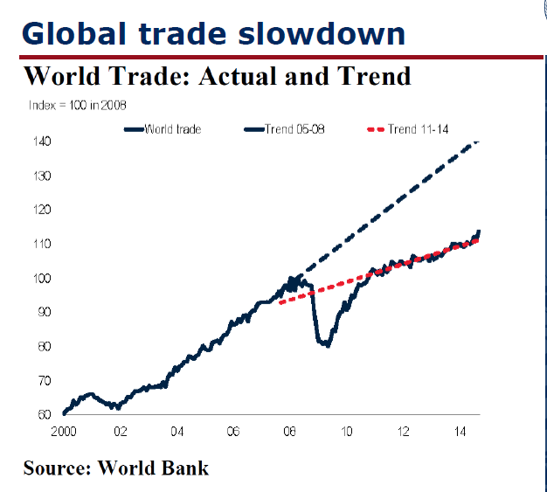
WHAT TO EXPECT?
First of all, we need to adapt to the New Normal

Slide 19
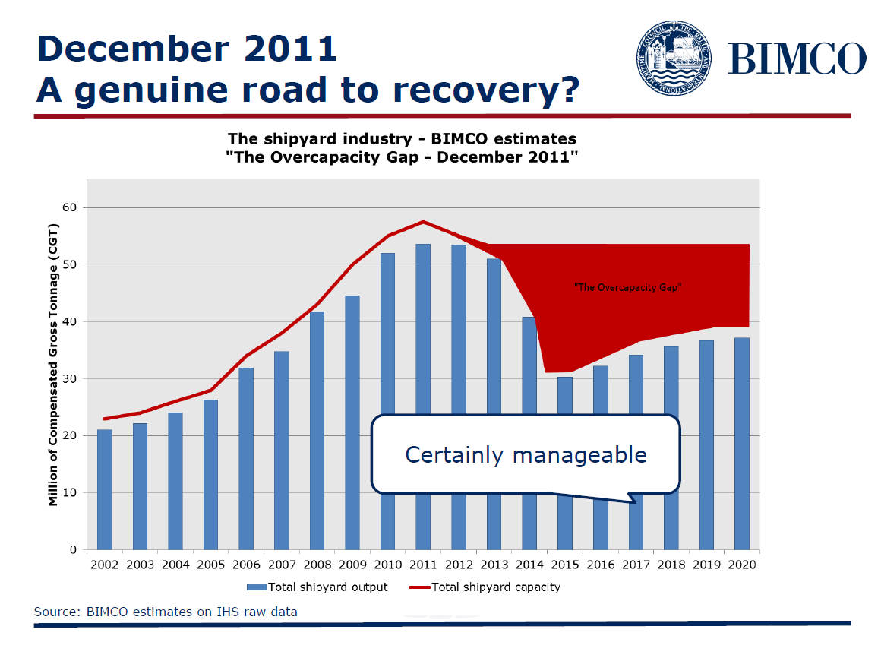

Slide 20
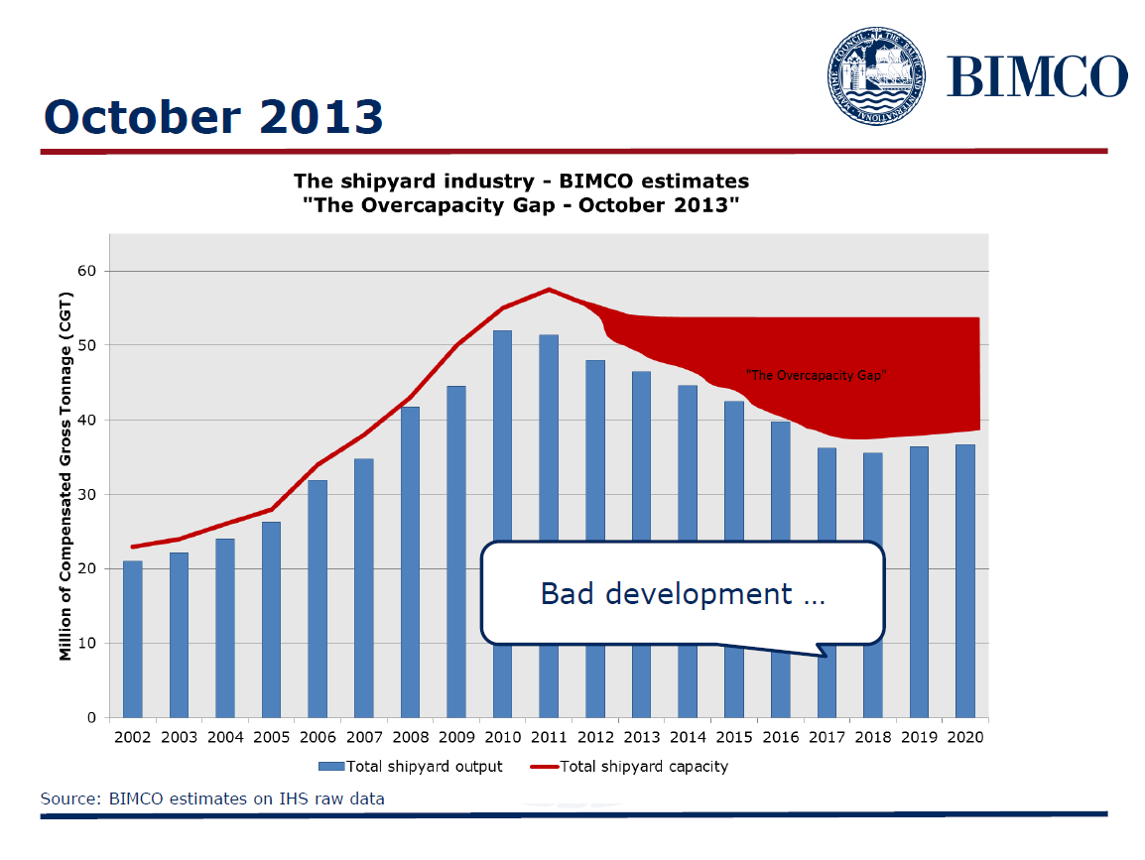

Slide 21
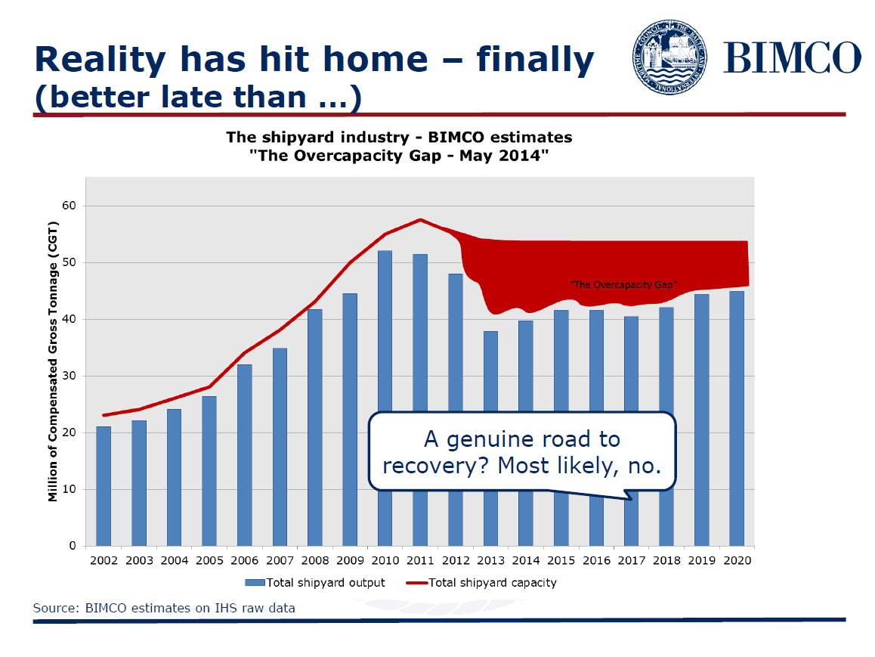

Slide 22


Slide 23
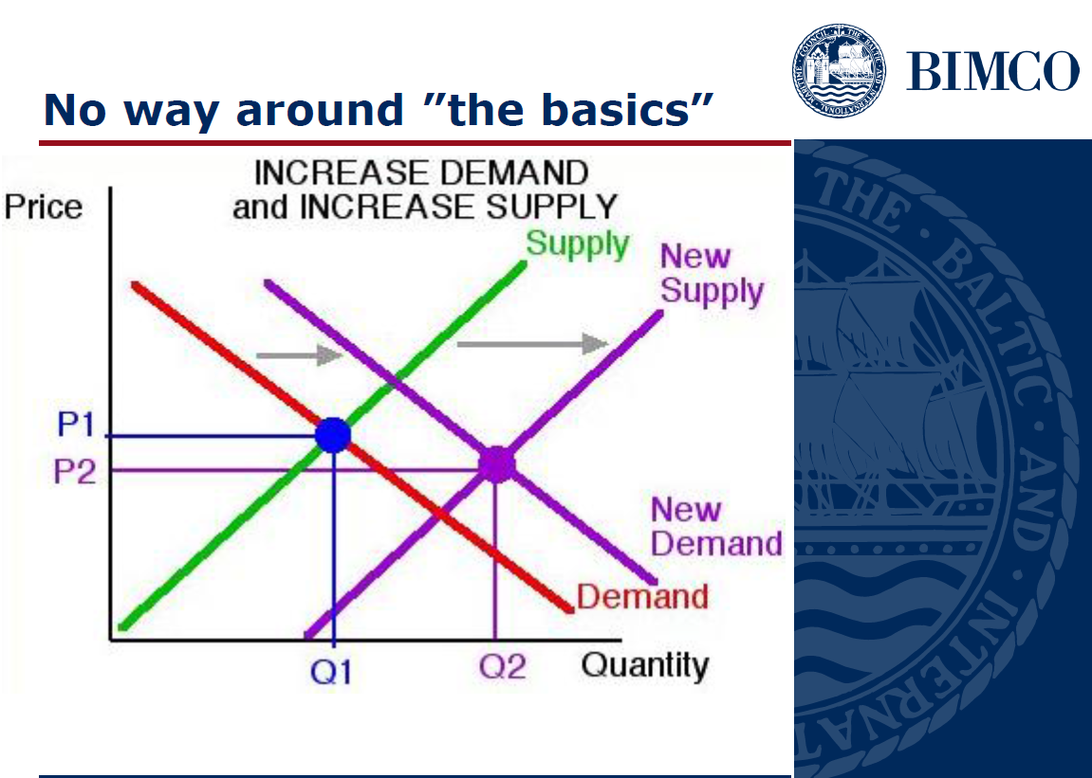
SIMPLE:

Slide 24
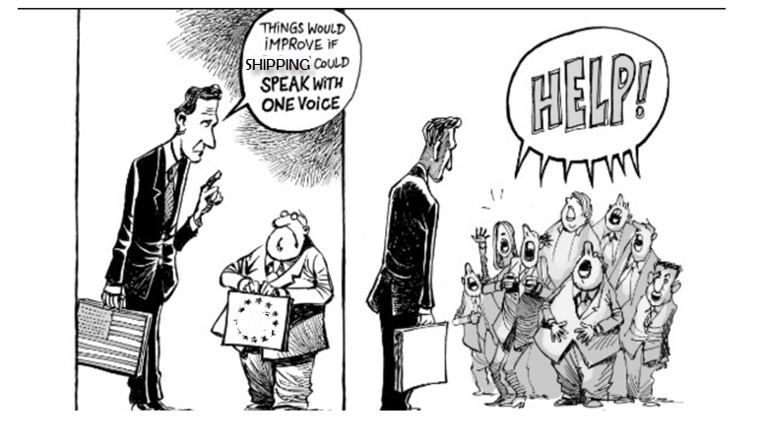
DON’T PANIC!!!!
2015
IT
CAN
HELP!

Slide 25
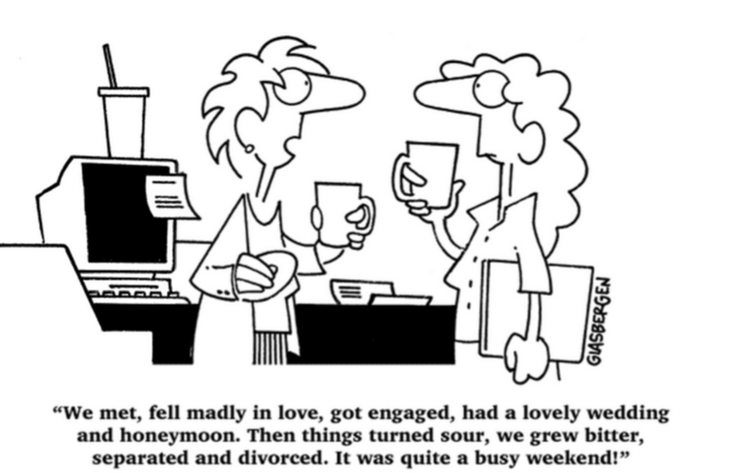
IT and SHIP MANAGEMENT
A difficult wedding but a needed one
2015

Slide 26
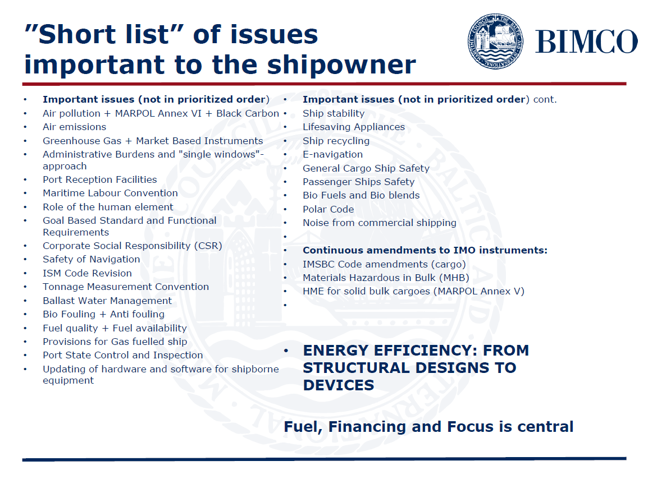
Shipping has become tougher than it ever was

Slide 27

WHAT TO DO THEN?
2015
OPTION 1:

Slide 28
WHAT TO DO THEN?
OPTION 2:
  BECOME MORE EFFICIENT IN MANAGING YOUR VESSELS
    Many shipowners have NO IDEA on how much money is being wasted on their ships
    They also have NO IDEA on how much money is being stolen from them
  Efficiency is a must in surviving in the next years. And to be efficient, you need IT
2015

Slide 29
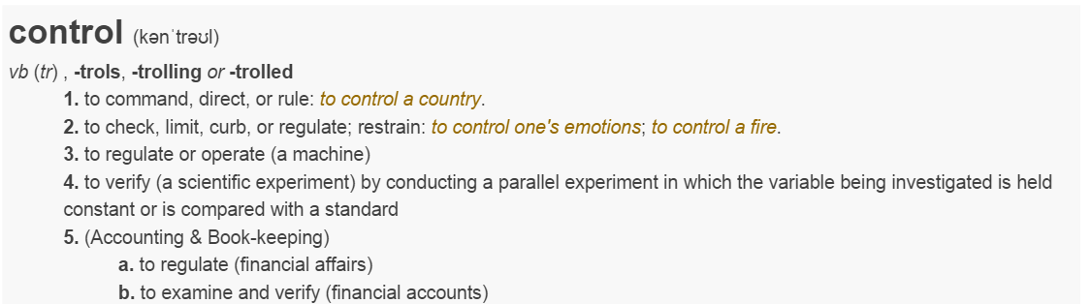
Management and Control
2015
Management means Control
Control means:
And many people do not like or want control

Slide 30
A basic mistake
Top Management is always involved
with the money that comes in
BUT WHAT ABOUT CONTROLLING
THE MONEY WHICH GOES OUT???

Slide 31
FACTS.....
NAME | STATUS | AMOS ON BOARD?
Beluga shipping | Bankrupt | NO
Korea lines | Bankrupt | NO
General Maritime | Bankrupt (Ch.11) | NO
Eagle Bulk | Under restructuring | NO
BLT Malaysia | Close to bankruptcy | NO
Deiulemar Shipping | Bankrupt | NO
D’Amato Giuseppe | Bankrupt | NO
Di Maio Lines | Bankrupt | NO
TORM | Trying to recover | NO
Rizzo Bottiglieri Carlini | Bankrupt | NO
Saarland | Bankrupt | NO
Marco Polo | Bankrupt | NO
OMEGA Shipping | Bankrupt | NO
Sanko | Bankrupt | NO
Navigator | Bankrupt | NO
NEL Lines | Bankrupt | NO
Allied Maritime | Bankrupt | NO
B&H Ocean | Bankrupt | NO
OSG | Bankrupt (Ch.11) | NO
Daebo International | Court receivership | NO
Winland Ocean Shipping | Filed for bankruptcy | NO
Copenship | Filed for bankruptcy | NO
> 150 KG companies
have gone bankrupt
in Germany, for over
700 ships.
NOT ONE had a FMS
installed

Slide 32
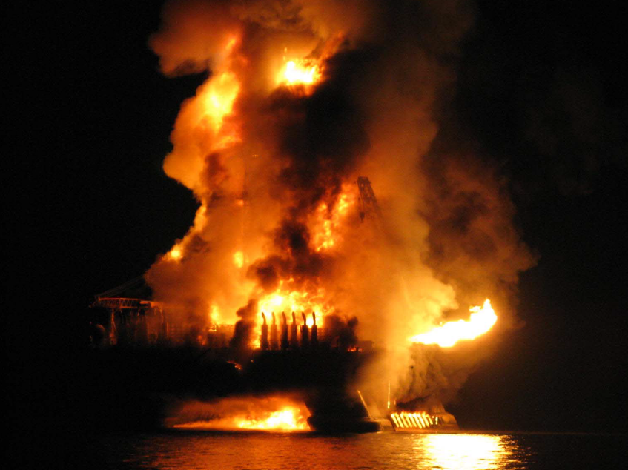
The cost of lack of control

Slide 34
Is there a link? YES
No Fleet Management Software on vessel?
  No control on spares = waste and pilferage
  No control on Maintenance = More failures = higher repair costs, out of service costs, higher insurance costs
  No control on Documentation: Fines due to wrong/missing documentation on vessel
  Costs due to possible arrests
  Easier for crews to «create» Magic Pipes incidents to cash rewards
  More difficult to shipowner to justify due diligence behavior in case of accidents and incidents

Slide 35
Where do shipping companies lose money
There are so many areas where money can be lost, that it is difficult to list them all:
Lack of control on spares (lost, forgotten) | Too many spares ordered | Too many POs (lack of consolidation practices)
Too few POs (lack of discount possibilities) | Always buying from same suppliers (lack of discounts) | Wrong maintenance
Wrong spares ordered | Too little maintenance (breakdowns) | Too much maintenance
Failure to comply with rules (PSC fines or arrests) | Higher insurance costs due to problems | Pilferage (on spares and fuel)

Slide 36
Options 3…. Or is it a threat?
LOOK INTO THE FUTURE:
  Ships with no or little crews
  Remote Maintenance Management
  Maintenance service contracts with suppliers
  Management by exception via deep BI and KPI analysis
  PMS+CBM linked with Automation Plant to provide real time data trends to Offices
  Electronic documentation

Slide 37
NEED FOR RADICAL CHANGES
It is not possible to continue by working as 100 years ago
Shipping is no different from any other industries:
  We need to do more with less
  We need to be super efficient to make money, as competition is high and profitability is low
  Profitability is in efficient management of vessels:
    Not possible to increase prices
    Which means reducing costs by avoiding waste

Slide 38
Where?
Reduction of spares
Selection of best suppliers
Reduction of costs per PO: consolidation, analysis of stocks
Avoidance of losses due to lack of control, stealing, lack of attention
Maintenance when needed
Lower insurance costs
Service agreements

Slide 39

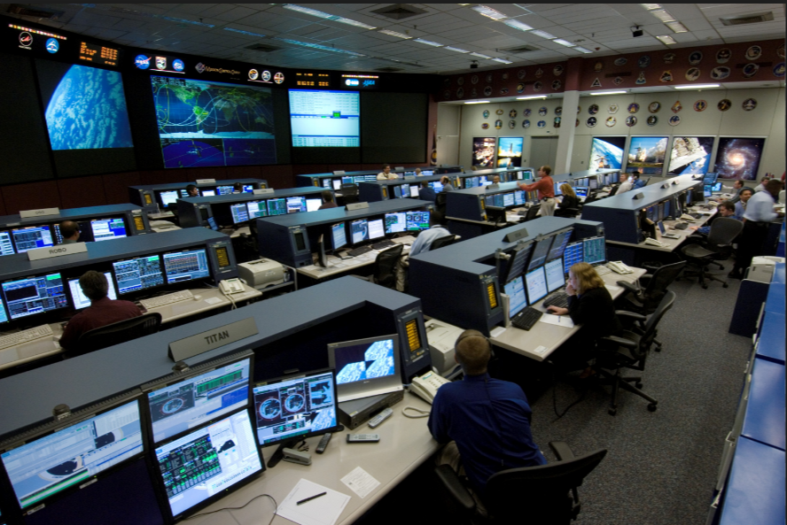
WE NEED TO CHANGE!
TODAY
TOMORROW

Slide 40
REMEMBER DARWIN LAW:
It is not the strongest of the species that survives,
nor the most intelligent that survives.
It is the one that is the most adaptable to change.

